Slide 1
Meeting: xx/xx-202x
- meeting

Slide 2
Election of moderator and refer

Slide 3
Summary from last meeting
Something here

Slide 4
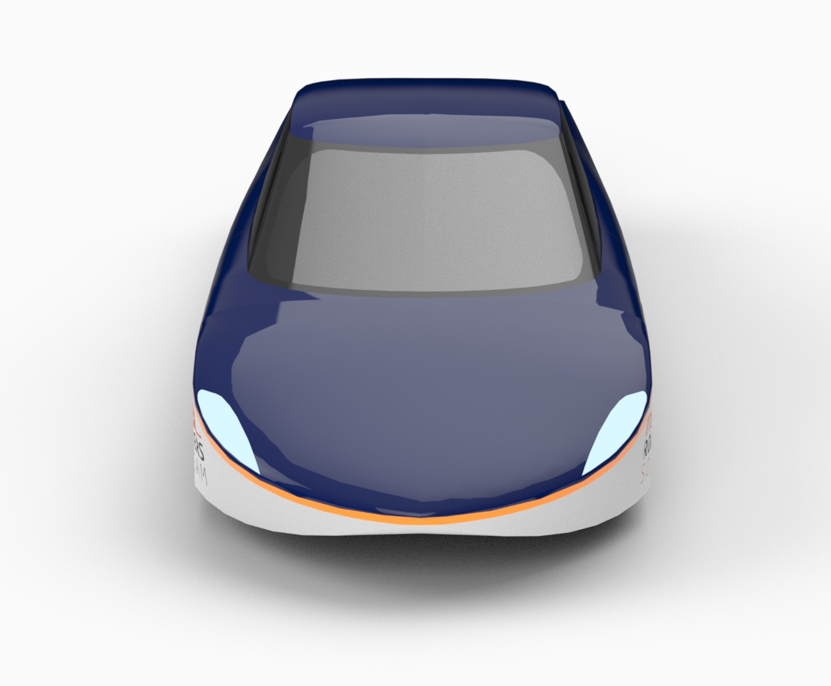
Agenda
Something here

Slide 5
Table example
Project | Start | End | Members
Shell | Stand by |  | Victor, Nikolaj, Peter, Kent & Asgar
Suspension | October 2023 | April 2024 | Victor
Steering | December 2023 | April 2024 | Asger & Rasmus
Cooling system | September 2023 | Maj 2024 | Anders
Motor test | February 2024 | Maj 2024 | Anders
Digital sidemirror shell | January 2024 | June 2024 | Anders
Mechanical sidemirror | February 2024 | June2024 | Magnus V., Jakob B., Magnus R., Carl C., Frederik S.
Head light shells | February 2024 | June 2024 | Thomas
Wheels | February 2024 | June 2024 | Thomas V., Hector B., Mikkel R., Mads. H.,
Cabine cooling | February 2024 | June 2024 | Adam V., Jonathan L.
Windscreen wipers | February 2024 | June 2024 | August T.
Brake system | November 2023 | December 2023 | Alexander og Co.

Slide 6
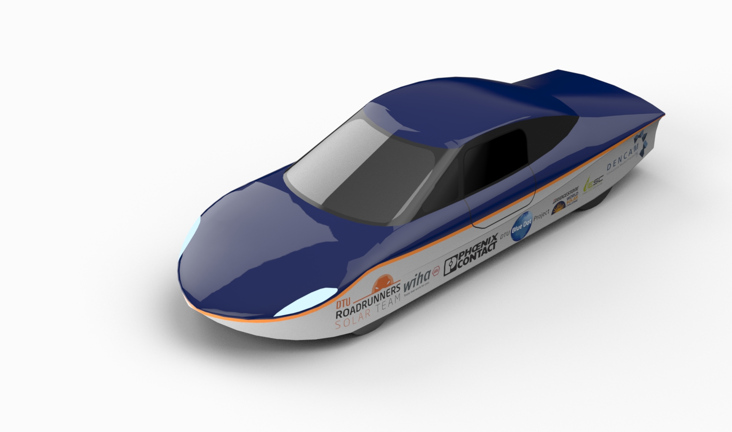
Other slide

Slide 7
Split
Something
Something

Slide 8
Agenda points for next meeting
Next management meeting (xx/xx-202x):
-
Next general meeting (general xx/xx-202x):
Remember:
Agenda points should be sent to:
-mail here
At the latest 2 days before the meeting

Slide 9
Feedback
What worked?
What can be improved?
Wishes for upcoming meetings?

